Slide 1

UCLA CA Epsilon
“Integrity and excellence in engineering.”
Fall 2014 Candidate Orientation
Fall 2016 Candidate Orientation

Slide 2
Presentation Roadmap
Introductions
Our Chapter
Requirements to Join
Notes:
Anthony

Slide 3
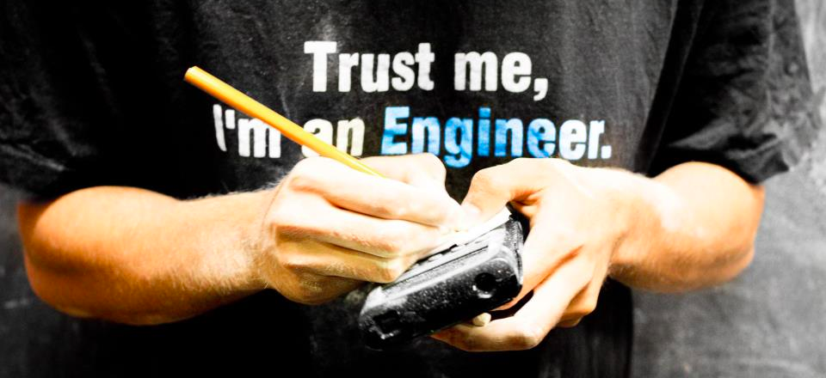
Introductions
Alex Sorokin | Robby Parker | Amir Dailamy
President 4th year Chemical | Vice-President 4th year Chemical | Vice-President 4th year Bio

Slide 4
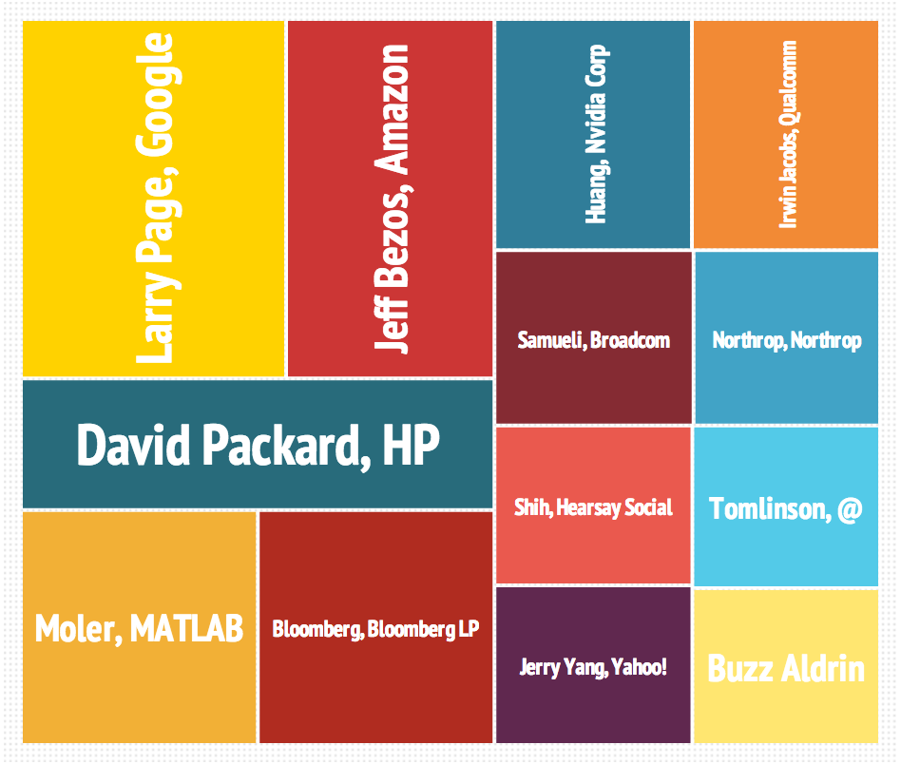
Distinguished Members
Over 240 chapters and 540,000 members
67 astronauts
19 Nobel Laureates, 21 Nobel Prizes
40 professors at UCLA, including Deans Dhir and Murthy
Notes:
Rachel

Slide 5
Misconceptions
Tau Beta Pi is a fraternity
We do have fun, but our events serve the engineering community.
Membership is just for show
Real benefits: leadership, networking, and career opportunities
There is a big time commitment
Most people only spend 2-3 hours a week on the candidacy process.
Notes:
Anthony

Slide 6
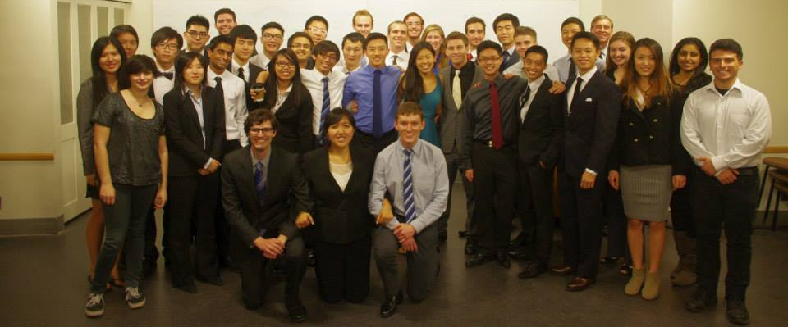
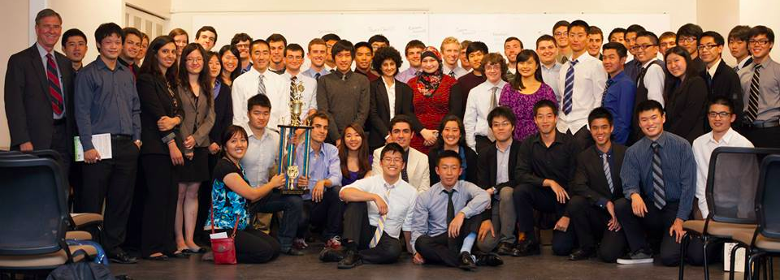
CA Epsilon Chapter
Established in 1952
5th chapter in California
Notes:
Anthony

Slide 7
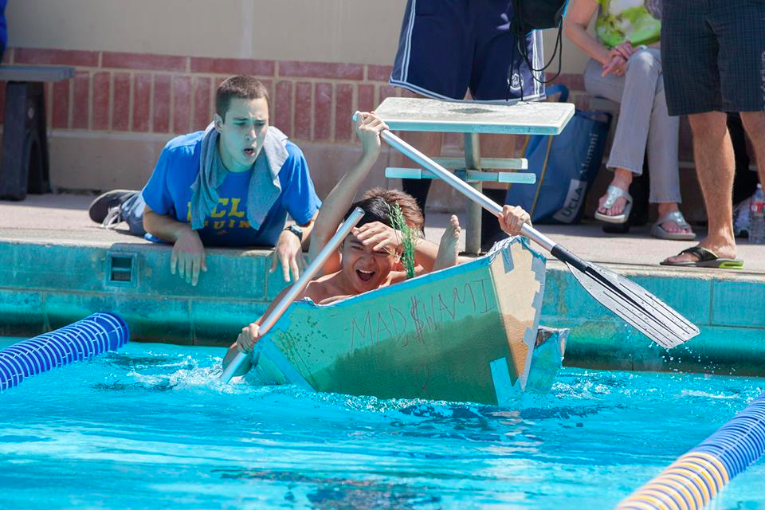
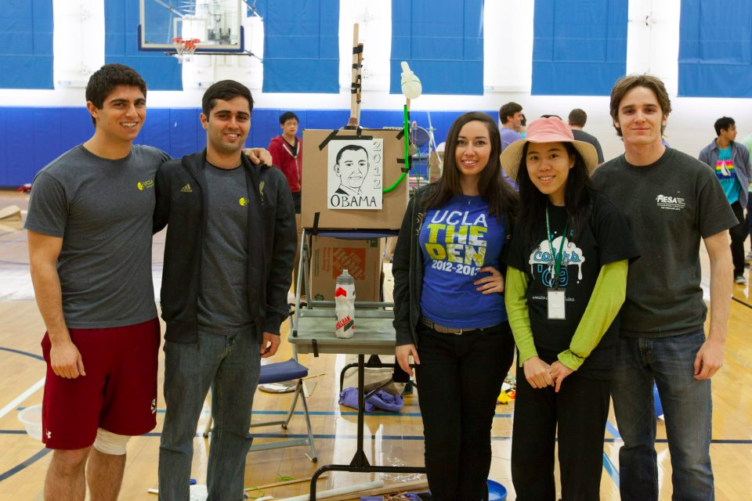
What We Do
Tutoring
EMCC
Academic Outreach
Community Service
Social Events
Notes:
Anthony

Slide 8
Why Join?
Leadership and service opportunities
Practical teamwork skills
Alumni and faculty network
Merit-based recognition
Scholarships and fellowships
Hotel, GEICO, PPI review material discounts
Notes:
Rachel

Slide 9
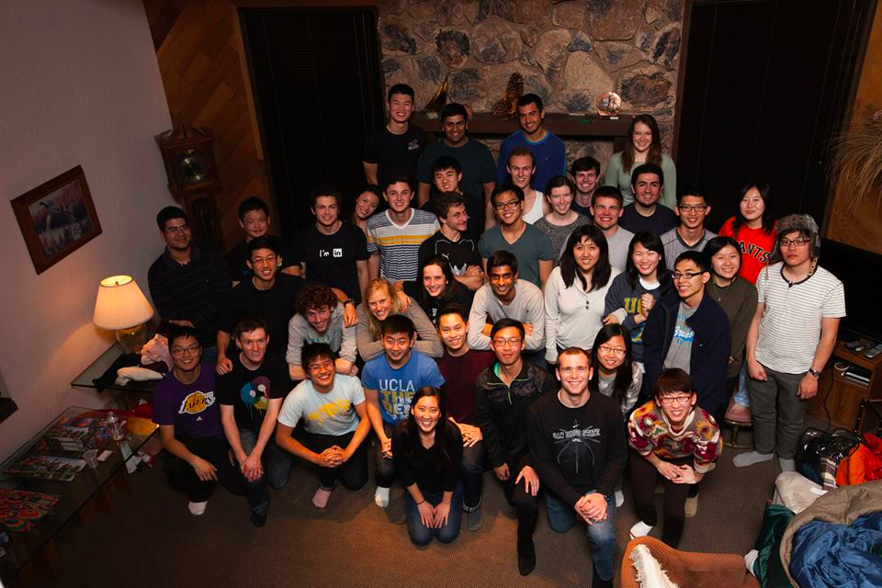
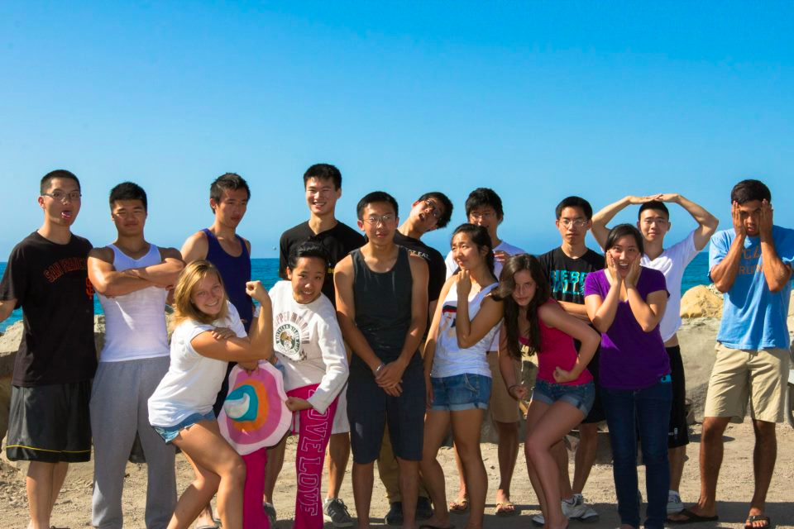
Fun Times!
Our other goal? Have lots of fun!
Skiing at Big Bear, Six Flags, movie night, BBQ, laser tag, board game night
Notes:
Rachel

Slide 10
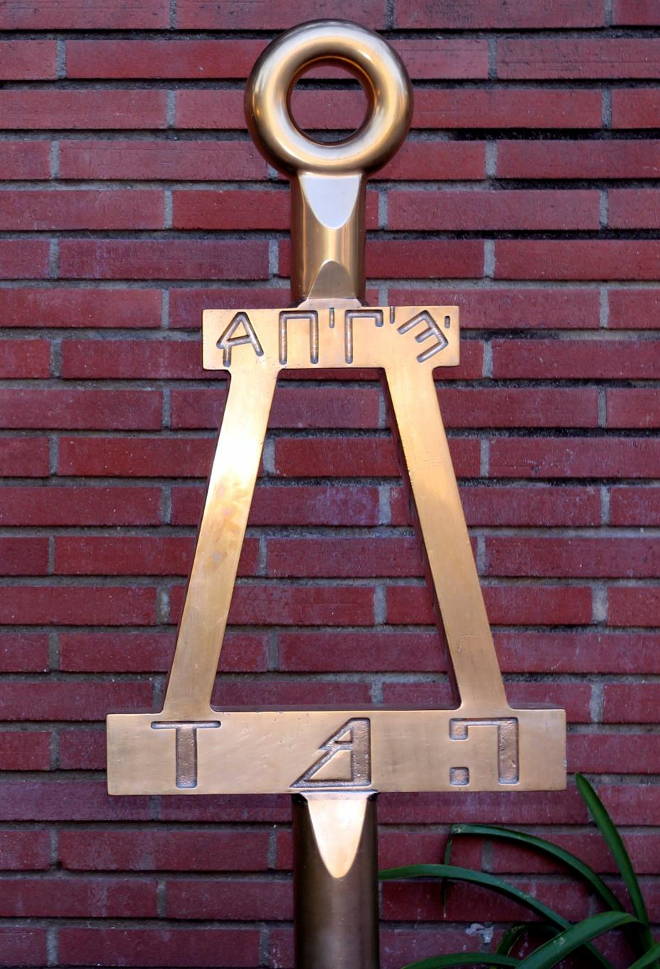
How to Join
Weekly Volunteering
Core Requirements
Event Requirements

Slide 11
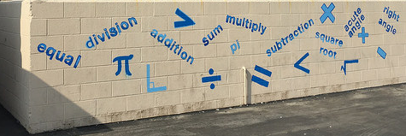
Weekly Volunteering
Tutoring
Academic Outreach Review Sessions
EMCC Elementary School Workshops

Slide 12
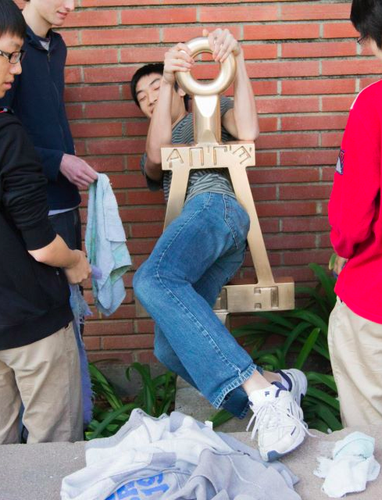
Core Requirements
Bent Polish
Candidate Quiz + One-Time Fee
Engineering Futures Workshop
Resume Submission
Initiation

Slide 13
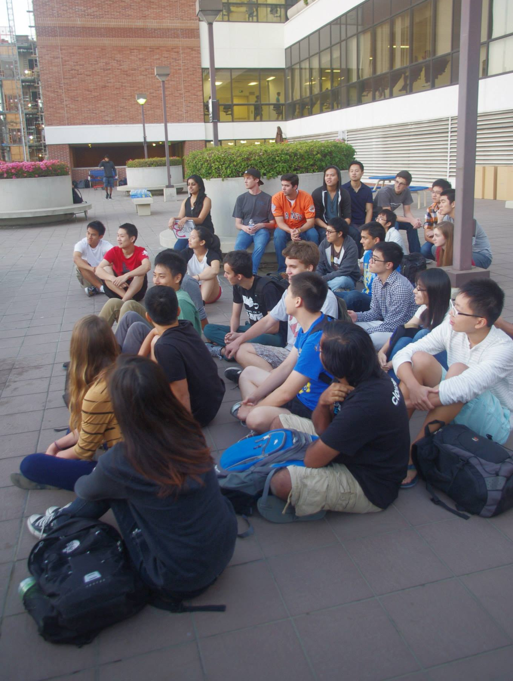
Event Requirements
2 Social Events, e.g.
Dinner or Movies in Westwood
Signature Project
2 Chapter Events, e.g.
Interviews
Meet & Greet
4 Hours of Service
Community Service
Volunteering (Not Weekly Requirement)

Slide 14
Upcoming Events and Deadlines
Sign up for a weekly program and confirm your candidacy by this Sunday, October 2nd
Candidate Sorting: Thursday of Week 2, October 6th, 6 – 8 pm, at the Bent
Tutoring Begins Monday of Week 3, October 10th
Notes:
Rachel

Slide 15
Thank You for Coming!
We hope you take this opportunity to join a great organization.
If you have any questions, stick around and ask the officers!
You can also contact us any time at taubetapi@seas.ucla.edu.
Notes:
Rachel

